Slide 1

Subject Name : Data Structures and Algorithms
Subject Code : 22CSE108
Total Contact Hours : 45
Credits : 03 L-T-P : 1-1-2
FACULTY OF
ENGINEERING
AND TECHNOLOGY

Slide 2
Module - 3
Trees and Graphs -
Definition of Trees, Binary Trees, Traversals and Threads, Binary Search Trees, Insertion and Deletion Algorithms, AVL Tree - Height-Balanced and Weight-Balanced Trees, B-Trees, B+ Trees, Heap Tree, Application of Trees; Hash tables; Graphs -Representations, Graphs Traversals - Breadth-First And Depth-First Search, Applications of Graphs – Model of www, Resource Allocation Graph
FACULTY OF
ENGINEERING
AND TECHNOLOGY
Faculty Name : Dr. Vianny

Slide 3
Module - 3
Introduction to Tree
FACULTY OF
ENGINEERING
AND TECHNOLOGY

Slide 4
TREE
Tree is a non-linear data structure which organizes data in hierarchical structure and this is a recursive definition.
A tree is hierarchical collection of nodes.
One of the nodes, known as the root, is at the top of the hierarchy.
The node where the link originates is called the parent node.
The root node has no parent.
The links leaving a node (any number of links are allowed) point to child nodes.
Each child node is itself the root of a subtree.
At the bottom of the tree are leaf nodes, which have no children.
FACULTY OF
ENGINEERING
AND TECHNOLOGY

Slide 5
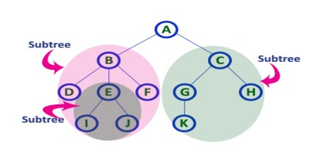
TREE
Introduction Terminology
In a Tree, Every individual element is called as Node.
Node in a tree data structure, stores the actual data of that particular element and link to next element in hierarchical structure.
FACULTY OF
ENGINEERING
AND TECHNOLOGY

Slide 6
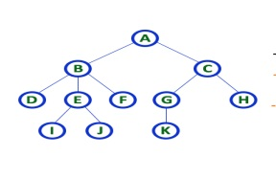
TREE
Root
In a tree data structure, the first node is called as Root Node.
Every tree must have root node.
We can say that root node is the origin of tree data structure.
In any tree, there must be only one root node.
A is a Root node.
FACULTY OF
ENGINEERING
AND TECHNOLOGY

Slide 7
TREE
Edge
In a tree data structure, the connecting link between any two nodes is called as EDGE.
In a tree with 'N' number of nodes there will be a maximum of 'N-1' number of edges.
Parent
In a tree data structure, the node which is predecessor of any node is called as PARENT NODE.
In simple words, the node which has branch from it to any other node is called as parent node.
Child
In a tree data structure, the node which is descendant of any node is called as CHILD Node.
FACULTY OF
ENGINEERING
AND TECHNOLOGY

Slide 8
TREE
In simple words, the node which has a link from its parent node is called as child node.
In a tree, any parent node can have any number of child nodes.
In a tree, all the nodes except root are child nodes.
e.g., Children of D are (H, I,J).
Siblings
In a tree data structure, nodes which belong to same Parent are called as SIBLINGS.
In simple words, the nodes with same parent are called as Sibling nodes. Ex: Siblings (B,C, D)
FACULTY OF
ENGINEERING
AND TECHNOLOGY

Slide 9
TREE
Leaf
In a tree data structure, the node which does not have a child (or) node with degree zero is called as LEAF Node.
In simple words, a leaf is a node with no child.
In a tree data structure, the leaf nodes are also called as External Nodes.
In a tree, leaf node is also called as 'Terminal' node. Ex: (K,L,F,G,M,I,J)
Internal Nodes
In a tree data structure, the node which has atleast one child is called as INTERNAL Node.
In simple words, an internal node is a node with atleast one child.
FACULTY OF
ENGINEERING
AND TECHNOLOGY

Slide 10
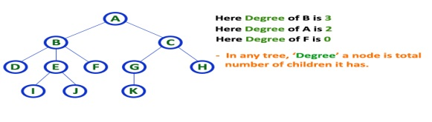
TREE
In a tree data structure, nodes other than leaf nodes are called as Internal Nodes.
Degree
In a tree data structure, the total number of children of a node (or)number of subtrees of a node is called as DEGREE of that Node.
In simple words, the Degree of a node is total number of children it has.
The highest degree of a node among all the nodes in a tree is called as 'Degree of Tree'
FACULTY OF
ENGINEERING
AND TECHNOLOGY

Slide 11
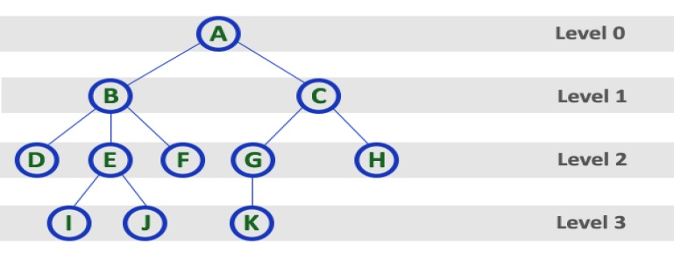
TREE
Level
In a tree data structure, the root node is said to be at Level 0 and the children of root node are at Level 1 and the children of the nodes which are at Level 1 will be at Level 2 and so on...
In simple words, in a tree each step from top to bottom is called as a Level and the Level count starts with '0' and incremented by one at each level (Step).
FACULTY OF
ENGINEERING
AND TECHNOLOGY

Slide 12
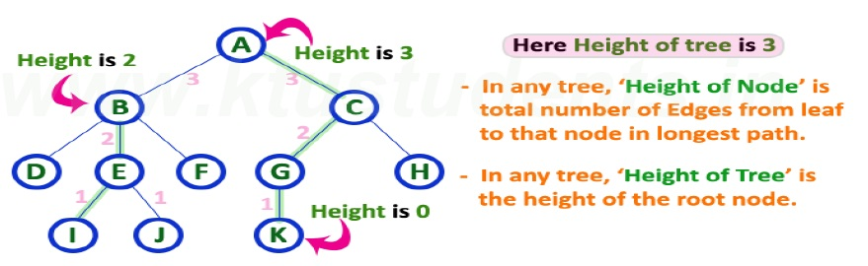
TREE
Height
In a tree data structure, the total number of edges from leaf node to a particular node in the longest path is called as HEIGHT of that Node.
In a tree, height of the root node is said to be height of the tree.
In a tree, height of all leaf nodes is '0‘
FACULTY OF
ENGINEERING
AND TECHNOLOGY

Slide 13
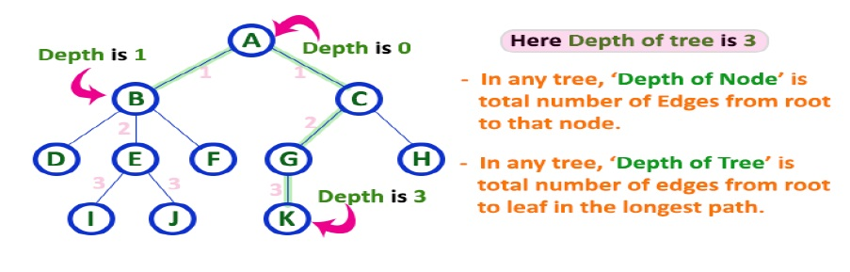
TREE
Depth
In a tree data structure, the total number of edges from root node to a particular node is called as DEPTH of that Node.
In a tree, the total number of edges from root node to a leaf node in the longest path is said to be Depth of the tree.
e. In simple words, the highest depth of any leaf node in a tree is said to be depth of that tree.
In a tree, depth of the root node is '0'.
FACULTY OF
ENGINEERING
AND TECHNOLOGY

Slide 14
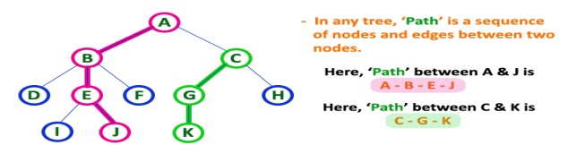
TREE
Path
In a tree data structure, the sequence of Nodes and Edges from one node to another node is called as PATH between that two Nodes.
Length of a Path is total number of nodes in that path.
In below example the path A - B - E - J has length 4.
FACULTY OF
ENGINEERING
AND TECHNOLOGY

Slide 15
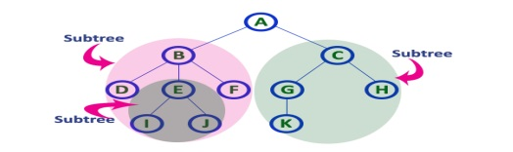
TREE
Sub Tree
In a tree data structure, each child from a node forms a subtree recursively.
Every child node will form a subtree on its parent node.
FACULTY OF
ENGINEERING
AND TECHNOLOGY

Slide 16
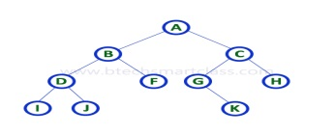
Binary Trees
In a normal tree, every node can have any number of children.
Binary tree is a special type of tree data structure in which every node can have a maximum of 2 children.
One is known as left child and the other is known as right child.
A tree in which every node can have a maximum of two children is called as Binary Tree.
In a binary tree, every node can have either 0 children or 1 child or 2 children but not more than 2 children.
FACULTY OF
ENGINEERING
AND TECHNOLOGY

Slide 17
Binary Trees
There are different types of binary trees are,
1. Strictly Binary Tree
In a binary tree, every node can have a maximum of two children.
But in strictly binary tree, every node should have exactly two children or none.
A binary tree in which every node has either two or zero number of children is called Strictly Binary Tree.
Strictly binary tree is also called as Full Binary Tree or Proper Binary Tree or 2-Tree
FACULTY OF
ENGINEERING
AND TECHNOLOGY

Slide 18
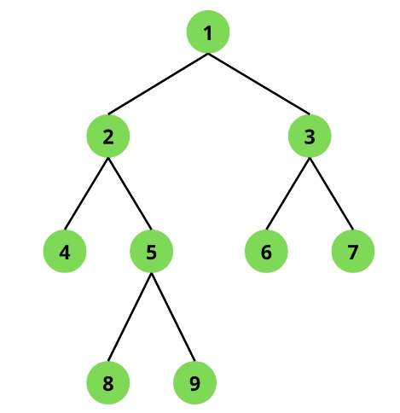
Binary Trees
FACULTY OF
ENGINEERING
AND TECHNOLOGY

Slide 19
Binary Trees
2. Complete Binary Tree
Every node should have exactly two children or none and in complete binary tree all the nodes must have exactly two children and at every level of complete binary tree there must be 2 level number of nodes.
A binary tree in which every internal node has exactly two children and all leaf nodes are at same level is called Complete Binary Tree.
FACULTY OF
ENGINEERING
AND TECHNOLOGY

Slide 20
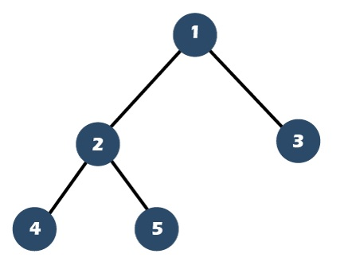
Binary Trees
FACULTY OF
ENGINEERING
AND TECHNOLOGY

Slide 21
Binary Trees
Perfect Binary Tree
A Binary tree is a Perfect Binary Tree if all the internal nodes have 2 children and the levels are completely filled, including the last level.
The leaf nodes are present at the same level which forms the last level of the tree. All Perfect Binary trees are Strict Binary Tree.
All the internal nodes have 2 children.
Leaf nodes are at the same level.
FACULTY OF
ENGINEERING
AND TECHNOLOGY

Slide 22
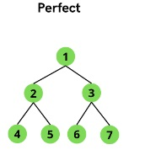
Binary Trees
FACULTY OF
ENGINEERING
AND TECHNOLOGY

Slide 23
Binary Trees
Binary Tree Representation
A binary tree data structure is represented using two methods.
1)Array Representation
2)Linked List Representation
Array Representation
In array representation of binary tree, we use a one dimensional array (1-D Array) to represent a binary tree.
A complete binary tree with n nodes (depth = log n + 1) is represented sequentially .
any node with index i, 1<=i<=n, we have: a) parent(i) is at i/2 if i!=1.
If i=1, i is at the root and has no parent.
FACULTY OF
ENGINEERING
AND TECHNOLOGY

Slide 24
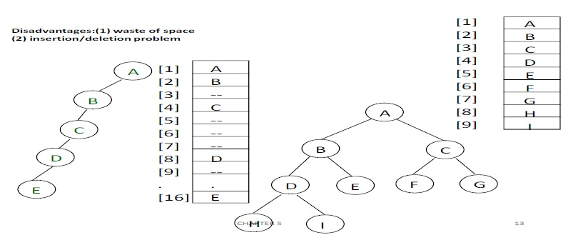
Binary Trees
b)left_child(i) ia at 2i if 2i<=n.
If 2i>n, then i has no left child.
c) right_child(i) is at 2i+1 if 2i +1 <=n.
If 2i +1 >n, then i has no right child.
FACULTY OF
ENGINEERING
AND TECHNOLOGY

Slide 25
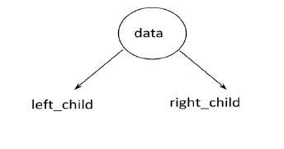
Binary Trees
Linked Representation
We use linked list to represent a binary tree.
In a linked list, every node consists of three fields.
First field, for storing left child address, second for storing actual data and third for storing right child address.
In this linked list representation, a node has the following structure...
FACULTY OF
ENGINEERING
AND TECHNOLOGY

Slide 26
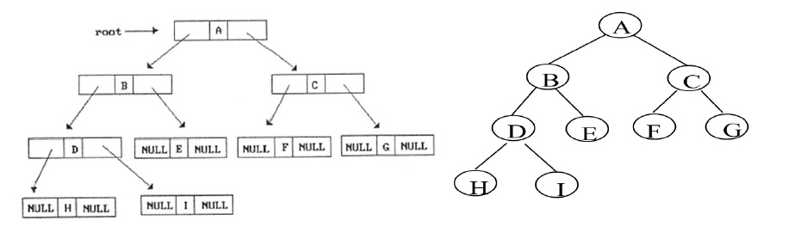
Binary Trees
FACULTY OF
ENGINEERING
AND TECHNOLOGY

Slide 27
Binary Trees
Binary Tree Traversals
When we wanted to display a binary tree, we need to follow some order in which all the nodes of that binary tree must be displayed.
In any binary tree displaying order of nodes depends on the traversal method.
Displaying (or) visiting order of nodes in a binary tree is called as Binary Tree Traversal.
There are three types of binary tree traversals.
1)In - Order Traversal
2)Pre - Order Traversal
3)Post - Order Traversal
FACULTY OF
ENGINEERING
AND TECHNOLOGY

Slide 28
Binary Trees
1. In - Order Traversal ( leftChild - root - rightChild )
In In-Order traversal, the root node is visited between left child and right child.
In this traversal, the left child node is visited first, then the root node is visited and later we go for visiting right child node.
This in-order traversal is applicable for every root node of all subtrees in the tree.
This is performed recursively for all nodes in the tree.
FACULTY OF
ENGINEERING
AND TECHNOLOGY

Slide 29
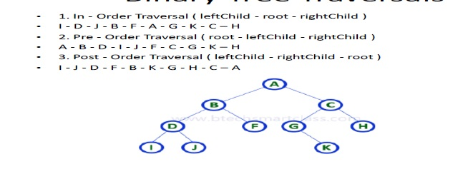
Binary Trees
Algorithm
Until all nodes are traversed −
Step 1 − Recursively traverse left subtree.
Step 2 − Visit root node.
Step 3 − Recursively traverse right subtree.
FACULTY OF
ENGINEERING
AND TECHNOLOGY

Slide 30
Binary Trees
In the above example of binary tree, first we try to visit left child of root node 'A', but A's left child is a root node for left subtree.
so we try to visit its (B's) left child 'D' and again D is a root for subtree with nodes D, I and J.
So we try to visit its left child 'I' and it is the left most child.
So first we visit 'I'then go for its root node 'D' and later we visit D's right child 'J'.
With this we have completed the left part of node B.
Then visit 'B' and next B's right child 'F' is visited.
With this we have completed left part of node A.
Then visit root node 'A'. With this we have completed left and root parts of node A.
FACULTY OF
ENGINEERING
AND TECHNOLOGY

Slide 31
Binary Trees
Then we go for right part of the node A. In right of A again there is a subtree with root C.
So go for left child of C and again it is a subtree with root G. But G does not have left part so we visit 'G' and then visit G's right child K.
With this we have completed the left part of node C.
Then visit root node'C' and next visit C's right child 'H' which is the right most child in the tree so we stop the process.
That means here we have visited in the order of I - D - J - B - F - A - G - K - C - H using In-Order Traversal.
FACULTY OF
ENGINEERING
AND TECHNOLOGY

Slide 32
Binary Trees
2. Pre - Order Traversal ( root - leftChild - rightChild )
In Pre-Order traversal, the root node is visited before left child and right child nodes.
In this traversal, the root node is visited first, then its left child and later its right child.
This pre-order traversal is applicable for every root node of all subtrees in the tree.
Algorithm
Until all nodes are traversed −
Step 1 − Visit root node.
Step 2 − Recursively traverse left subtree.
Step 3 − Recursively traverse right subtree.
FACULTY OF
ENGINEERING
AND TECHNOLOGY

Slide 33
Binary Trees
FACULTY OF
ENGINEERING
AND TECHNOLOGY

Slide 34
Binary Trees
In the above example of binary tree, first we visit root node 'A' then visit its left child 'B' which is a root for D and F.
So we visit B's left child 'D' and again D is a root for I and J.
So we visit D's left child'I' which is the left most child.
So next we go for visiting D's right child 'J'.
With this we have completed root, left and right parts of node D and root, left parts of node B.
Next visit B's right child'F'. With this we have completed root and left parts of node A.
So we go for A's right child 'C' which is a root node for G and H. After visiting C, we go for its left child 'G' which is a root for node K.
So next we visit left of G, but it does not have left child so we go for G's right child 'K'.
FACULTY OF
ENGINEERING
AND TECHNOLOGY

Slide 35
Binary Trees
With this we have completed node C's root and left parts.
Next visit C's right child 'H' which is the right most child in the tree. So we stop the process.
That means here we have visited in the order of A-B-D-I-J-F-C-G-K-H using Pre-Order Traversal.
FACULTY OF
ENGINEERING
AND TECHNOLOGY

Slide 36
Binary Trees
3. Post - Order Traversal ( leftChild - rightChild - root )
In Post-Order traversal, the root node is visited after left child and right child. In this traversal, left child node is visited first, then its right child and then its root node.
This is recursively performed until the right most node is visited.
Here we have visited in the order of I - J - D - F - B - K - G - H - C - A using Post-Order Traversal.
Algorithm
Until all nodes are traversed −
Step 1 − Recursively traverse left subtree.
Step 2 − Recursively traverse right subtree.
Step 3 − Visit root node.
FACULTY OF
ENGINEERING
AND TECHNOLOGY

Slide 37
Binary Trees
FACULTY OF
ENGINEERING
AND TECHNOLOGY

Slide 38
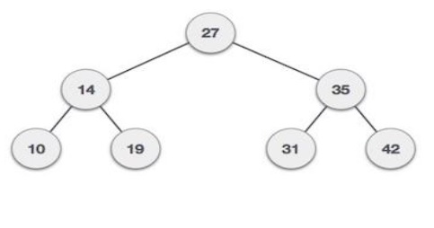
Binary Search Trees
Binary Search tree exhibits a special behavior.
A node's left child must have value less than its parent's value and node's right child must have value greater than it's parent value.
FACULTY OF
ENGINEERING
AND TECHNOLOGY

Slide 39
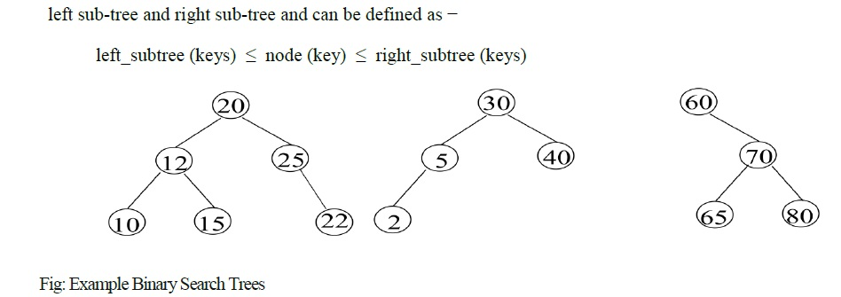
Binary Search Trees
Definition: A binary search tree (BST) is a binary tree. It may be empty. If it is not empty, then all nodes follows the below mentioned properties −
Every element has a unique key.
The keys in a nonempty left subtree (right subtree) are smaller (larger) than the key in the root of subtree.
The keys in a nonempty right subtree larger than the key in the root of subtree.
The left and right subtrees are also binary search trees.
FACULTY OF
ENGINEERING
AND TECHNOLOGY

Slide 40
Binary Search Trees
BST Basic Operations
Search − search an element in a binary search tree.
Insert − insert an element into a binary search tree / create a tree.
Delete − Delete an element from a binary search tree.
Height -- Height of a binary search tree.
FACULTY OF
ENGINEERING
AND TECHNOLOGY

Slide 41
Binary Search Trees
Inserting into a Binary Search Tree
The very first insertion creates the tree.
Afterwards, whenever an element is to be inserted. First locate its proper location.
Start search from root node then if data is less than key value, search empty location in left sub tree and insert the data.
Otherwise search empty location in right sub tree and insert the data.
In a binary search tree, the insertion operation is performed with O(log n) time complexity.
In binary search tree, new node is always inserted as a leaf node.
The insertion operation is performed as follows.
FACULTY OF
ENGINEERING
AND TECHNOLOGY

Slide 42
Binary Search Trees
Step 1: Create a newNode with given value and set its left and right to NULL.
Step 2: Check whether tree is Empty.
Step 3: If the tree is Empty, then set set root to newNode.
Step 4: If the tree is Not Empty, then check whether value of newNode is smaller or larger than the node (here it is root node).
Step 5: If newNode is smaller than or equal to the node, then move to its left child. If newNode is larger than the node, then move to its right child.
Step 6: Repeat the above step until we reach a node (e.i., reach to NULL) where search terminates.
Step 7: After reaching a last node, then insert the newNode as left child if newNode is smaller or equal to that node else insert it as right child.
FACULTY OF
ENGINEERING
AND TECHNOLOGY

Slide 43
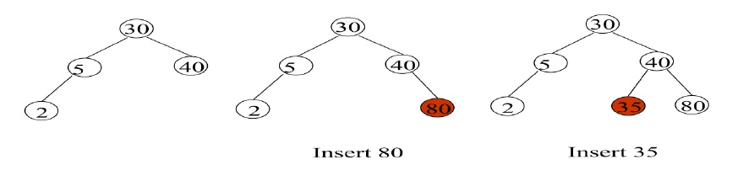
Binary Search Trees
Algorithm
Create newnode
If root is NULL
then create root node
return
If root exists then
compare the data with node.data
while until insertion position is located
If data is greater than node.data
FACULTY OF
ENGINEERING
AND TECHNOLOGY

Slide 44
Binary Search Trees
goto right subtree
else
goto left subtree
endwhile
insert newnode
end If
Deleting a node
Remove operation on binary search tree is more complicated, than insert and search. Basically, in can be divided into two stages:
search for a node to remove
if the node is found, run remove algorithm.
FACULTY OF
ENGINEERING
AND TECHNOLOGY

Slide 45
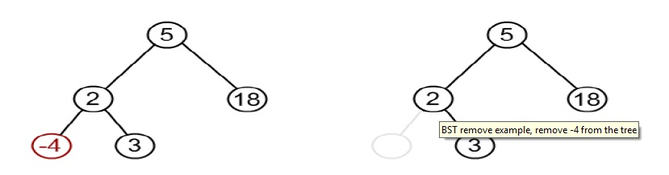
Binary Search Trees
First stage is identical to algorithm for lookup, except we should track the parent of the current node.
Second part is more tricky. There are three cases, which are described below.
1.Node to be removed has no children. --This case is quite simple. Algorithm sets corresponding link of the parent to NULL and disposes the node.
Example. Remove -4 from a BST.
FACULTY OF
ENGINEERING
AND TECHNOLOGY

Slide 46
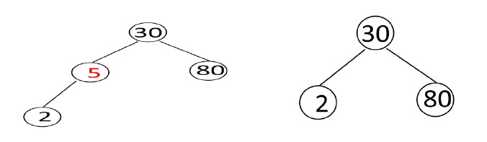
Binary Search Trees
2.Node to be removed has one child. In this case, node is cut from the tree and algorithm links single child (with it's subtree) directly to the parent of the removed node.
3.Node to be removed has two children. --This is the most complex case. The deleted node can be replaced by either largest key in its left subtree or the smallest in its right subtree. Preferably which node has one child.
FACULTY OF
ENGINEERING
AND TECHNOLOGY

Slide 47
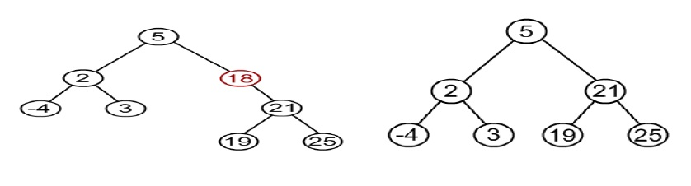
Binary Search Trees
Deletion Operation in BST
In a binary search tree, the deletion operation is performed with O(log n) time complexity. Deleting a node from Binary search tree has following three cases.
Case 1: Deleting a Leaf node (A node with no children)
Case 2: Deleting a node with one child
FACULTY OF
ENGINEERING
AND TECHNOLOGY

Slide 48
Binary Search Trees
Case 3: Deleting a node with two children
Case 1: Deleting a leaf node
We use the following steps to delete a leaf node from BST.
Step 1: Find the node to be deleted using search operation
Step 2: Delete the node using free function (If it is a leaf) and terminate the function.
Case 2: Deleting a node with one child
We use the following steps to delete a node with one child from BST.
Step 1: Find the node to be deleted using search operation
Step 2: If it has only one child, then create a link between its parent and child nodes.
Step 3: Delete the node using free function and terminate the function.
Case 3: Deleting a node with two children
We use the following steps to delete a node with two children from BST.
Step 1: Find the node to be deleted using search operation
Step 2: If it has two children, then find the largest node in its left subtree (OR) the smallest node in its right subtree.
FACULTY OF
ENGINEERING
AND TECHNOLOGY

Slide 49
Binary Search Trees
Step 3: Swap both deleting node and node which found in above step.
Step 4: Then, check whether deleting node came to case 1 or case 2 else goto steps 2
Step 5: If it comes to case 1, then delete using case 1 logic.
Step 6: If it comes to case 2, then delete using case 2 logic.
Step 7: Repeat the same process until node is deleted from the tree.
FACULTY OF
ENGINEERING
AND TECHNOLOGY

Slide 50
AVL Tree
An AVL Tree is a binary search tree such that for every internal node v of T, the heights of the children of v can differ by at most 1.
An empty tree is height balanced.
If T is a non empty binary tree with TL and TR as its left and right sub trees. The T is height balanced if and only if
i. TL and TR are height balanced.
ii. hL-hR <= 1 where hL and hR are heights of TL and TR.
The idea of balancing a tree is obtained by calculating the balance factor of a tree.
Balance Factor:
The balance factor BF(T) of a node in binary tree is defined to be hL-hR where hL and hR are heights of left and right sub trees of T.
For any node in AVL tree the balance factor i.e. BF(T) is -1, 0 or +1.
FACULTY OF
ENGINEERING
AND TECHNOLOGY

Slide 51
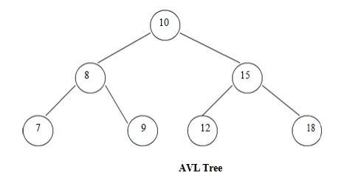
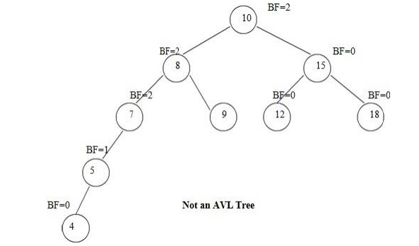
AVL Tree
FACULTY OF
ENGINEERING
AND TECHNOLOGY

Slide 52
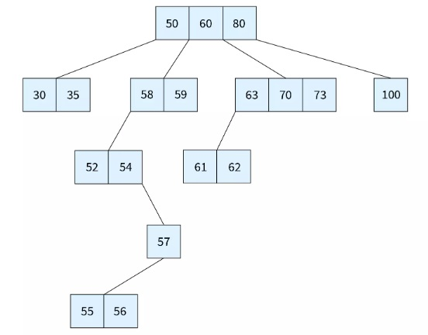
B Trees
Binary trees can have a maximum of 2 children
A Multi way Search Tree, commonly known as a M-way tree can yield a maximum of m children where m>2.
Due to their structure, M-way trees are mainly used in external searching
i.e. in situations where data is to be retrieved from secondary storage like disk files.
FACULTY OF
ENGINEERING
AND TECHNOLOGY

Slide 53
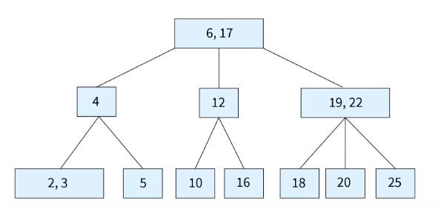
B Trees
The access time for secondary storage is much higher than that of primary storage, and thus our aim is to minimize the number of file accesses.
To do so, the height of the tree is reduced by forming an m-way tree. Lesser the height, more efficient is the external search.
That's where B tree comes in.
A B Tree (height Balanced m-way search Tree) is a special type of M-way tree which balances itself.
FACULTY OF
ENGINEERING
AND TECHNOLOGY

Slide 54
B Trees
It has [6,17] at the root. 4 that is lesser than 6 falls in the left child.
12 being lesser than 17 and greater than 6 is the middle child.
[19,22] that are greater than 17 are the rightmost child.
The same process follows as we go down the tree.
FACULTY OF
ENGINEERING
AND TECHNOLOGY

Slide 55
B Trees
Important Property of B Tree
A B Tree of order m can be defined as an m-way search tree which is either empty, or satisfies the following properties:
All leaf nodes of a B tree are at the same level, i.e. they have the same depth (height of the tree).
The keys of each node of a B tree (in case of multiple keys), should be stored in the ascending order.
In a B tree, all non-leaf nodes (except root node) should have at least m/2 children.
All nodes (except root node) should have at least m/2 - 1 keys.
If the root node is a leaf node (only node in the tree), then it will have no children and will have at least on ekey.
FACULTY OF
ENGINEERING
AND TECHNOLOGY

Slide 56
B Tree
If the root node is a non-leaf node, then it will have at least 2 children and at least one key.
A non-leaf node with n-1 key values should have n non NULL children.
FACULTY OF
ENGINEERING
AND TECHNOLOGY

Slide 57
B Trees
All the leaf nodes are at the same height.
Each node doesn't have multiple values mandatorily, but if it does, then they will be stored in ascending order. Eg: In the figure given, the keys are stored as [19,22] (ascending order).
Considering the order of the tree of 4, so each node (except root) has at least 1 key.
we can conclude that any node (except the root) in B tree is at least half full and this avoids wastage of space.
The B tree is perfectly balanced so that the number of nodes accessed to find a key becomes less.
FACULTY OF
ENGINEERING
AND TECHNOLOGY

Slide 58
B Trees
The B tree data structure is needed due to the following reasons:
B Tree is an extension of M-way tree. While B trees are self-balanced, In case of external storage, there is a need for faster access. Due to the self-balancing nature of a B tree, it had fewer levels and thus the access-time is cut short.
A B tree facilitates ordered sequential access and simplifies insertion and deletion of records when there are millions of records. This is possible due to the reduced height and balanced nature of the B tree.
FACULTY OF
ENGINEERING
AND TECHNOLOGY

Slide 59
B+ Trees
A B+ Tree is simply a balanced binary search tree, in which all data is stored in the leaf nodes, while the internal nodes store just the indices.
Each leaf is at the same height and all leaf nodes have links to the other leaf nodes.
The root node always has a minimum of two children.
The concept of B+ trees exists because of it being much more convenient, both in terms of operations on it, as well as efficiency.
Properties of B+ Trees
All data is stored in the leaf nodes, while the internal nodes store just the indices.
Each leaf is at the same height.
All leaf nodes have links to the other leaf nodes.
FACULTY OF
ENGINEERING
AND TECHNOLOGY

Slide 60
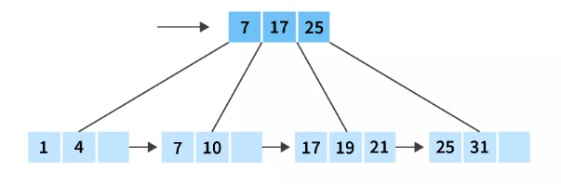
B+ Trees
The root node has a minimum of two children.
Each node except root can have a maximum of m children and a minimum of m/2 children.
Each node can contain a maximum of m-1 keys and a minimum of ⌈m/2⌉ - 1 keys.
FACULTY OF
ENGINEERING
AND TECHNOLOGY

Slide 61
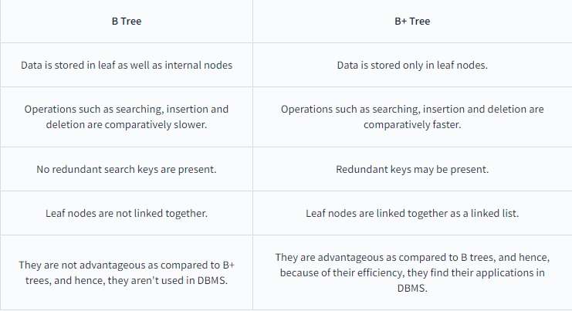
B+ Trees
Values stored in the internal nodes act as pointers to the actual data present in the leaf nodes.
leaf nodes are linked to each other, making up a linked list.
Difference Between B Tree and B+ Tree
FACULTY OF
ENGINEERING
AND TECHNOLOGY

Slide 62
B+ Trees
Advantages of B+ Tree
Height of the B+ tree is always balanced and is comparitively lesser than B tree.
It takes equal number of disk accesses to fetch records.
Keys are used for indexing.
Because the data is only stored on the leaf nodes, search queries are faster.
Data stored in a B+ tree can be accesssed both sequentially and directly.
FACULTY OF
ENGINEERING
AND TECHNOLOGY

Slide 63
B+ Trees
Applications of B+ Tree
B+ trees in DBMS plays a useful role by supporting equality and range search.
It also facilitates database indexing in DBMS.
Another advantage is multilevel indexing.
FACULTY OF
ENGINEERING
AND TECHNOLOGY

Slide 64
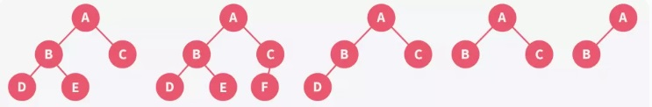
Heap Trees
Heap is a special case of balanced binary tree data structure where the root-node key is compared with its children and arranged accordingly.
Min-Heap − Where the value of the root node is less than or equal to either of its children.
Max-Heap − Where the value of the root node is greater than or equal to either of its children.
Complete Binary tree
FACULTY OF
ENGINEERING
AND TECHNOLOGY

Slide 65
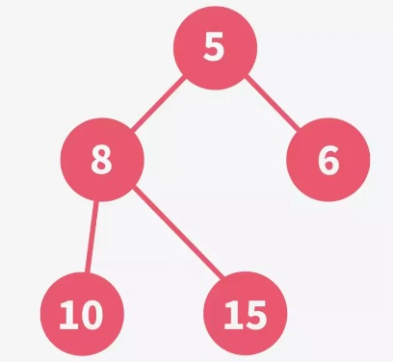
Heap Trees
Types of Heaps
Min-heap:
If in a complete binary tree, all the nodes (including the root) are smaller than their respective child nodes, it is known as a min-heap.
In a min-heap, the root element is always the smallest of all the elements present in the heap.
FACULTY OF
ENGINEERING
AND TECHNOLOGY

Slide 66
Heap Trees
Types of Heaps
Max-heap
If in a complete binary tree, all the nodes (including the root) are greater than their respective child nodes, it is known as a max-heap.
In a max-heap, the root element is always the greatest of all the elements present in the heap.
Consider the following tree. It is a complete binary tree. Notice that 15 is greater than both of its children, 10 and 8.
Same for element 10 which is greater than its children, 6 and 5. Thus, we can say that it is a max-heap.
FACULTY OF
ENGINEERING
AND TECHNOLOGY

Slide 67
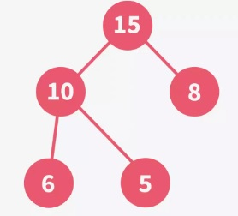
Heap Trees
Types of Heaps
Max-heap
Heapify is the process of rearranging the elements to form a tree that maintains the properties of the heap data structure.
FACULTY OF
ENGINEERING
AND TECHNOLOGY

Slide 68
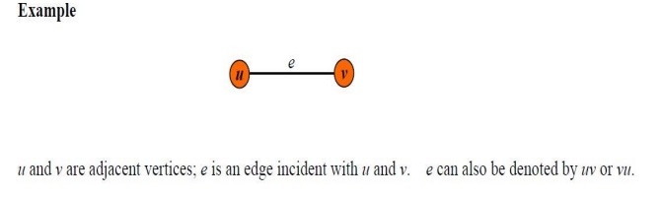
GRAPH
A graph G is a discrete structure consisting of nodes (called vertices) and lines joining the nodes (called edges).
Two vertices are adjacent to each other if they are joint by an edge.
The edge joining the two vertices is said to be an edge incident with them.
We use V (G) and E(G) to denote the set of vertices and edges of G respectively.
FACULTY OF
ENGINEERING
AND TECHNOLOGY

Slide 69
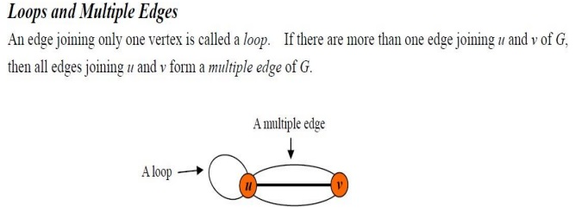
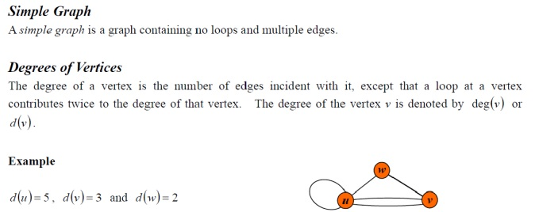
GRAPH
FACULTY OF
ENGINEERING
AND TECHNOLOGY

Slide 70
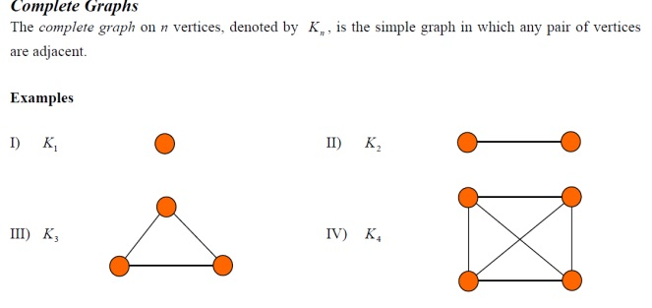
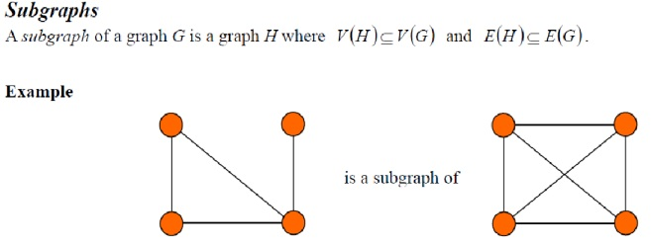
GRAPH
FACULTY OF
ENGINEERING
AND TECHNOLOGY

Slide 71
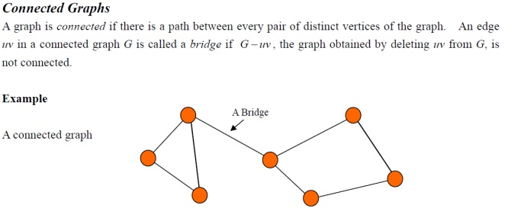
GRAPH
Euler Circuit and Euler Path - An Euler circuit in a graph G is a simple circuit containing every edge of G. An Euler path in G is a simple path containing every edge of G.
FACULTY OF
ENGINEERING
AND TECHNOLOGY

Slide 72
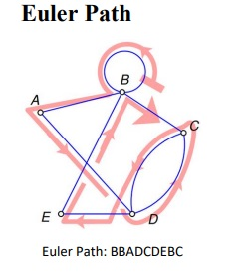
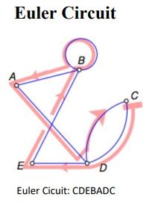
GRAPH
FACULTY OF
ENGINEERING
AND TECHNOLOGY

Slide 73
GRAPH
Graph Representations
Graph data structure is represented using following representations.
Adjacency Matrix
Incidence Matrix
Adjacency List
Adjacency Matrix
In this representation, graph can be represented using a matrix of size total number of vertices by total number of vertices.
That means if a graph with 4 vertices can be represented using a matrix of 4X4 class.
In this matrix, rows and columns both represents vertices.
FACULTY OF
ENGINEERING
AND TECHNOLOGY

Slide 74
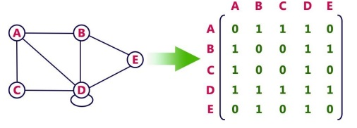
GRAPH
This matrix is filled with either 1 or 0.
Here, 1 represents there is an edge from row vertex to column vertex and 0 represents there is no edge from row vertex to column vertex.
For example, consider the following undirected graph representation.
FACULTY OF
ENGINEERING
AND TECHNOLOGY

Slide 75
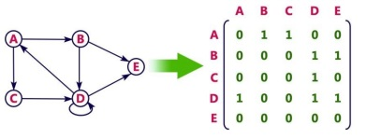
GRAPH
Directed graph representation.
FACULTY OF
ENGINEERING
AND TECHNOLOGY

Slide 76
GRAPH
Incidence Matrix
In this representation, graph can be represented using a matrix of size total number of vertices by total number of edges.
That means if a graph with 4 vertices and 6 edges can be represented using a matrix of 4X6 class.
In this matrix, rows represents vertices and columns represents edges.
This matrix is filled with either 0 or 1 or -1.
Here, 0 represents row edge is not connected to column vertex.
1 represents row edge is connected as outgoing edge to column vertex .
-1 represents row edge is connected as incoming edge to column vertex.
FACULTY OF
ENGINEERING
AND TECHNOLOGY

Slide 77
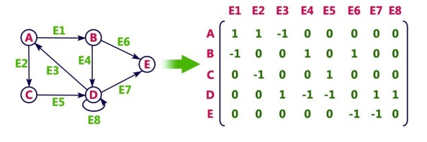
GRAPH
Incidence Matrix
FACULTY OF
ENGINEERING
AND TECHNOLOGY

Slide 78
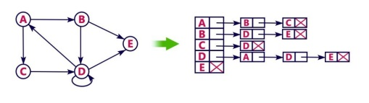
GRAPH
Adjacency List
In this representation, every vertex of graph contains list of its adjacent vertices.
For example, consider the following directed graph representation implemented using linked list.
FACULTY OF
ENGINEERING
AND TECHNOLOGY

Slide 79
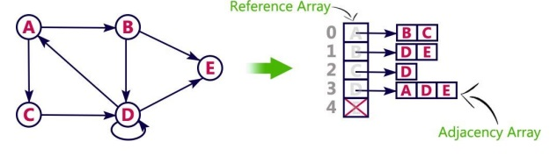
GRAPH
Adjacency List
This representation can also be implemented using array as follows.
FACULTY OF
ENGINEERING
AND TECHNOLOGY

Slide 80
GRAPH
Graph traversals
Graph traversal means visiting every vertex and edge exactly once in a well-defined order.
While using certain graph algorithms, you must ensure that each vertex of the graph is visited exactly once.
The order in which the vertices are visited are important and may depend upon the algorithm or question that you are solving.
During a traversal, it is important that you track which vertices have been visited.
The most common way of tracking vertices is to mark them.
FACULTY OF
ENGINEERING
AND TECHNOLOGY

Slide 81
GRAPH
Graph traversals
Depth First Search (DFS)
Breadth First Search (BFS)
Depth First Search (DFS)
The DFS algorithm is a recursive algorithm that uses the idea of backtracking.
It involves exhaustive searches of all the nodes by going ahead, if possible, else by backtracking.
Here, the word backtrack means that when you are moving forward and there are no more nodes along the current path, you move backwards on the same path to find nodes to traverse.
FACULTY OF
ENGINEERING
AND TECHNOLOGY

Slide 82
GRAPH
All the nodes will be visited on the current path till all the unvisited nodes have been traversed after which the next path will be selected.
This recursive nature of DFS can be implemented using stacks.
The basic idea is as follows:
Pick a starting node and push all its adjacent nodes into a stack.
Pop a node from stack to select the next node to visit and push all its adjacent nodes into a stack.
Repeat this process until the stack is empty.
However, ensure that the nodes that are visited are marked.
This will prevent you from visiting the same node more than once.
If you do not mark the nodes that are visited and you visit the same node more than once, you may end up in an infinite loop.
FACULTY OF
ENGINEERING
AND TECHNOLOGY

Slide 83
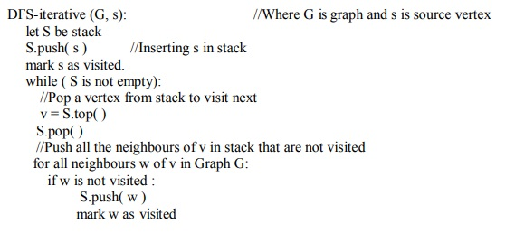
GRAPH
Iterative
FACULTY OF
ENGINEERING
AND TECHNOLOGY

Slide 84
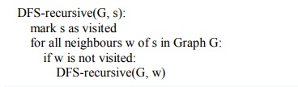
GRAPH
Recursive
FACULTY OF
ENGINEERING
AND TECHNOLOGY

Slide 85
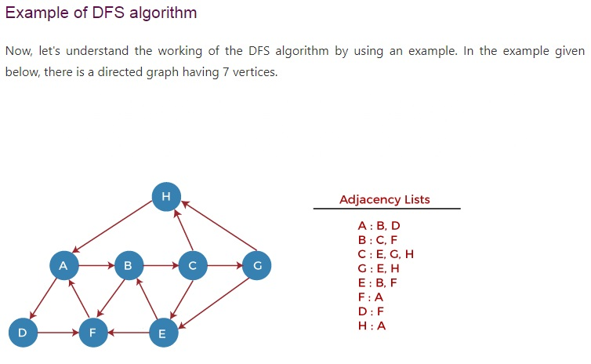
GRAPH
FACULTY OF
ENGINEERING
AND TECHNOLOGY

Slide 86
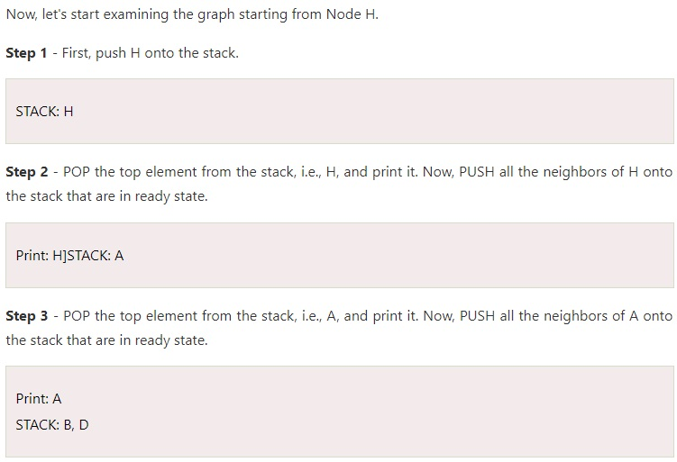
GRAPH
FACULTY OF
ENGINEERING
AND TECHNOLOGY

Slide 87


GRAPH
Step 4 - POP the top element from the stack, i.e., D, and print it. Now, PUSH all the neighbors of D onto the stack that are in ready state.
Step 5 - POP the top element from the stack, i.e., F, and print it. Now, PUSH all the neighbors of F onto the stack that are in ready state.
Step 6 - POP the top element from the stack, i.e., B, and print it. Now, PUSH all the neighbors of B onto the stack that are in ready state.
FACULTY OF
ENGINEERING
AND TECHNOLOGY

Slide 88
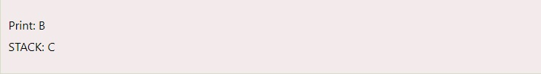
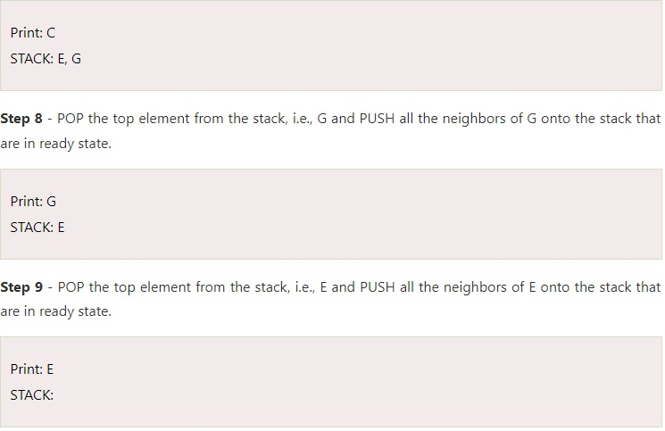
GRAPH
Step 7 - POP the top element from the stack, i.e., C, and print it. Now, PUSH all the neighbors of C onto the stack that are in ready state.
FACULTY OF
ENGINEERING
AND TECHNOLOGY

Slide 89
GRAPH
Now, all the graph nodes have been traversed, and the stack is empty.
The time complexity of the DFS algorithm is O(V+E), where V is the number of vertices and E is the number of edges in the graph.
The space complexity of the DFS algorithm is O(V).
FACULTY OF
ENGINEERING
AND TECHNOLOGY

Slide 90
GRAPH
Breadth First Search (BFS)
BFS is a traversing algorithm where you should start traversing from a selected node (source or starting node) and traverse the graph layerwise thus explori ng the neighbour nodes (nodes which are directly connected to source node).
You must then move towards the next level neighbour nodes.
This algorithm selects a single node (initial or source point) in a graph and then visits all the nodes adjacent to the selected node.
BFS accesses these nodes one by one.
Once the algorithm visits and marks the starting node, then it moves towards the nearest unvisited nodes and analyses them.
These iterations continue until all the nodes of the graph have been successfully visited and marked.
FACULTY OF
ENGINEERING
AND TECHNOLOGY

Slide 91
GRAPH
In this method of traversing, we select a node as a start node from where the traversal begins.
It is visited and marked, and all the unvisited nodes adjacent to the next node are visited and marked in an order.
Similarly, all the unvisited nodes of adjacent nodes are visited and marked
until full graph nodes are covered.
Algorithm:
1. Start
2. Consider a Graph G=(V, E)
3. Initially mark all the nodes of graph G as unseen
4. Add the Root node into the Queue Q from where it begins
5. Repeat until the Queue Q is empty
6. Remove the node from the Queue Q
7. If this popped node is having any unseen nodes, visit and mark all the unvisited nodes.
8. End
FACULTY OF
ENGINEERING
AND TECHNOLOGY

Slide 92

GRAPH
FACULTY OF
ENGINEERING
AND TECHNOLOGY

Slide 93

GRAPH
FACULTY OF
ENGINEERING
AND TECHNOLOGY

Slide 94
GRAPH
In the above graph, minimum path 'P' can be found by using the BFS that will start from Node A and end at Node E.
The algorithm uses two queues, namely QUEUE1 and QUEUE2. QUEUE1 holds all the nodes that are to be processed, while QUEUE2 holds all the nodes that are processed and deleted from QUEUE1.
Now, let's start examining the graph starting from Node A.
Step 1 - First, add A to queue1 and NULL to queue2.
QUEUE1 = {A}
QUEUE2 = {NULL}
Step 2 - Now, delete node A from queue1 and add it into queue2. Insert all neighbors of node A to queue1.
QUEUE1 = {B, D}
QUEUE2 = {A}
FACULTY OF
ENGINEERING
AND TECHNOLOGY

Slide 95
GRAPH
Step 3 - Now, delete node B from queue1 and add it into queue2. Insert all neighbors of node B to queue1.
QUEUE1 = {D, C, F}
QUEUE2 = {A, B}
Step 4 - Now, delete node D from queue1 and add it into queue2. Insert all neighbors of node D to queue1. The only neighbor of Node D is F since it is already inserted, so it will not be inserted again.
QUEUE1 = {C, F}
QUEUE2 = {A, B, D}
Step 5 - Delete node C from queue1 and add it into queue2. Insert all neighbors of node C to queue1.
QUEUE1 = {F, E, G}
QUEUE2 = {A, B, D, C}
FACULTY OF
ENGINEERING
AND TECHNOLOGY

Slide 96
GRAPH
Step 5 - Delete node F from queue1 and add it into queue2. Insert all neighbors of node F to queue1. Since all the neighbors of node F are already present, we will not insert them again.
QUEUE1 = {E, G}
QUEUE2 = {A, B, D, C, F}
Step 6 - Delete node E from queue1. Since all of its neighbors have already been added, so we will not insert them again. Now, all the nodes are visited, and the target node E is encountered into queue2.
QUEUE1 = {G}
QUEUE2 = {A, B, D, C, F, E}
FACULTY OF
ENGINEERING
AND TECHNOLOGY

Slide 97
GRAPH Applications
Social networks: A social network is by definition, well, a network. And graphs are special cases of networks, with only a single type of edge between vertices.
Web graphs: The web is a huge collection of documents pointing to each other via hyperlinks. In other words, the web is another massive graph data set.
Biological networks: The (biological) environment is actually one of the largest sources of real-world graphs. Examples are brain networks, protein interaction networks, food networks.
Knowledge graphs: The knowledge of the world is inherently graph-structured. Information A is connected to information B if A stands in relation to B in some specific way.
FACULTY OF
ENGINEERING
AND TECHNOLOGY

Slide 98
GRAPH Applications
Product recommendation graphs: If you buy a product, Amazon recommends you buying similar products. These recommended products are based on what other users have already bought.
Neural networks: Artificial neural networks are huge graphs connecting neurons via artificial synapses.
Road networks: Apps like Maze, Google Maps, Apple Maps, and Uber are installed on every smartphone.
Blockchains: The Blockchain is a large graph. The vertices are blocks, each storing many transactions. The edges connect subsequent blocks.
Bitcoin transaction graphs: The Blockchain is an interesting graph that is often analyzed in the cryptocurrency space.
FACULTY OF
ENGINEERING
AND TECHNOLOGY

Slide 99
GRAPH Applications
Web crawlers and search engines - A web crawler is a program that traverses the graph that is the Internet, looking for "interesting" pages to index. A search engine takes a query and presents pages from the index, with the most "interesting" ones first.
The index is a massive table; the keys are the content words, and the values are the associated URLs.
The crawler adds pages to the table, and the search engine retrieves them.
The crawler must also maintain a second table to know what pages it has visited already.
FACULTY OF
ENGINEERING
AND TECHNOLOGY

Slide 100
Resource Allocation Graph
The resource allocation graph is the pictorial representation of the state of a system.
As its name suggests, the resource allocation graph is the complete information about all the processes which are holding some resources or waiting for some resources.
It also contains the information about all the instances of all the resources whether they are available or being used by the processes.
In Resource allocation graph, the process is represented by a Circle while the Resource is represented by a rectangle.
Vertices are mainly of two types, Resource and process.
Each of them will be represented by a different shape. Circle represents process while rectangle represents resource.
FACULTY OF
ENGINEERING
AND TECHNOLOGY

Slide 101

Resource Allocation Graph
A resource can have more than one instance. Each instance will be represented by a dot inside the rectangle.
A resource is shown as assigned to a process if the tail of the arrow is attached to an instance to the resource and the head is attached to a process.
A process is shown as waiting for a resource if the tail of an arrow is attached to the process while the head is pointing towards the resource.
FACULTY OF
ENGINEERING
AND TECHNOLOGY

Slide 102

Resource Allocation Graph
Example
Let'sconsider 3 processes P1, P2 and P3, and two types of resources R1 and R2. The resources are having 1 instance each.
According to the graph, R1 is being used by P1, P2 is holding R2 and waiting for R1, P3 is waiting for R1 as well as R2.
The graph is deadlock free since no cycle is being formed in the graph.
FACULTY OF
ENGINEERING
AND TECHNOLOGY

Slide 103
HASH TABLE
Hash Table is a data structure which store data in associative manner.
In hash table, data is stored in array format where each data values has its own unique index value.
Access of data becomes very fast if we know the index of desired data.
Thus, it becomes a data structure in which insertion and search operations are very fast irrespective of size of data.
Hash Table uses array as a storage medium and uses hash technique to generate index where an element is to be inserted or to be located from.
Hashing
Hashing is a technique to convert a range of key values into a range of indexes of an array.
FACULTY OF
ENGINEERING
AND TECHNOLOGY

Slide 104

HASH TABLE
We're going to use modulo operator to get a range of key values.
Consider an example of hash table of size 20, and following items are to be stored. Item are in key, value format.
FACULTY OF
ENGINEERING
AND TECHNOLOGY

Slide 105


HASH TABLE
Linear Probing
It may happen that the hashing technique used create already used index of the array.
y. In such case, we can search the next empty location in the array by looking into the next cell until we found an empty cell.
This technique is called linear probing.
FACULTY OF
ENGINEERING
AND TECHNOLOGY

Slide 106

HASH TABLE
HASH FUNCTION
A hash function is an algorithm that converts a hash key to a hash value.
A good hash function is essential for the effective performance of the hash table.
FACULTY OF
ENGINEERING
AND TECHNOLOGY

Slide 107
HASH TABLE
The main requirements of a hash function are that it must:
always produce the same hash value for the same key.
provide a uniform distribution of hash values. This means that every value has an equal probability of being generated.
minimise clustering; this will arise when many different keys produce the same hash value. Where two or more different keys produce the same hash value, we say a ‘collision’ has occured.
be very fast to compute.
FACULTY OF
ENGINEERING
AND TECHNOLOGY

Slide 108
HASH TABLE
A simple hash function
Let's take a look at a simple hash function. Here we will assume that the keys are 5 digit numbers and we have a hash table with 97 buckets.
FUNCTION hash_integer(hash_key, number_of_slots)
// Generate the hash value using the modulo operator
hash_value = hash_key MOD number_of_slots
// Return the hash value
RETURN hash_value
ENDFUNCTION
FACULTY OF
ENGINEERING
AND TECHNOLOGY

Slide 109


HASH TABLE
TYPES OF HASH FUNCTION
1. Division Method:
The hash function depends upon the remainder of division. Typically the divisor is table length.
For eg; If the record 54, 72, 89, 37 is placed in the hash table and if the table size is 10 then
FACULTY OF
ENGINEERING
AND TECHNOLOGY

Slide 110
HASH TABLE
TYPES OF HASH FUNCTION
2. Mid Square:
In the mid square method, the key is squared and the middle or mid part of the result is used as the index.
If the key is a string, it has to be preprocessed to produce a number.
Consider that if we want to place a record 3111 then
(3111) squre = 9678321
for the hash table of size 1000
H(3111) = 783 (the middle 3 digits)
3. Multiplicative hash function:
The given record is multiplied by some constant value. The formula for computing the hash key is
FACULTY OF
ENGINEERING
AND TECHNOLOGY

Slide 111
HASH TABLE
TYPES OF HASH FUNCTION
H(key) = floor(p *(fractional part of key*A)) where p is integer constant and A is constant real number.
4. Digit Folding:
The key is divided into separate parts and using some simple operation these parts are combined to produce the hash key
For eg; consider a record 12365412 then it is divided into separate parts as 123 654 12 and these are added together
H(key) = 123+654+12 = 789
The record will be placed at location 789
FACULTY OF
ENGINEERING
AND TECHNOLOGY

Slide 112
HASH TABLE
COLLISION
The hash function is a function that returns the key value using which the record can be placed in the hash table.
Thus this function helps us in placing the record in the hash table at appropriate position and due to this we can retrieve the record directly from that location.
This function need to be designed very carefully and it should not return the same hash key address for two different records.
This is an undesirable situation in hashing.
Similarly when there is no room for a new pair in the hash table then such a situation is called overflow.
Collision and overflow show the poor hash functions.
FACULTY OF
ENGINEERING
AND TECHNOLOGY

Slide 113
HASH TABLE
COLLISION RESOLUTION TECHNIQUES
If collision occurs then it should be handled by applying some techniques.
Such a technique is called collision handling technique.
1.Chaining
2.Open addressing (linear probing)
3.Quadratic probing
4.Double hashing
5.Rehashing
FACULTY OF
ENGINEERING
AND TECHNOLOGY

Slide 114
HASH TABLE
COLLISION RESOLUTION TECHNIQUES
CHAINING
In collision handling method chaining is a concept which introduces an additional field with data i.e. chain.
A separate chain table is maintained for colliding data. When collision occurs then a linked list(chain) is maintained at the home bucket.
For eg; Consider the keys to be placed in their home buckets are 131, 3, 4, 21, 61, 7, 97, 8, 9
then we will apply a hash function as H(key) = key % D
Where D is the size of table. The hash table will beHere D = 10
FACULTY OF
ENGINEERING
AND TECHNOLOGY

Slide 115

HASH TABLE
COLLISION RESOLUTION TECHNIQUES
CHAINING
FACULTY OF
ENGINEERING
AND TECHNOLOGY

Slide 116
HASH TABLE
COLLISION RESOLUTION TECHNIQUES
Linear Probing
It may happen that the hashing technique used create already used index of the array.
y. In such case, we can search the next empty location in the array by looking into the next cell until we found an empty cell.
This technique is called linear probing.
FACULTY OF
ENGINEERING
AND TECHNOLOGY

